Slide 1
Agricultural Workforce Outlook: How Demographics, Technology, and Markets are Transforming Farm Labor
Richard Stup, Ph.D.
Agricultural Workforce Specialist
Cornell University
rstup@cornell.edu
agworkforce.cals.cornell.edu
Notes:
Employee Onboarding: The First Step to Develop and Retain the Best People Dr. Rich Stup, Cornell University Tuesday, January 22 10:15 - 11:00 a.m. and 11:10 a.m. - 11:55 a.m. Safe, Productive, and Confident… from Day One. Onboarding is the dairy’s chance to make a strong and lasting impression that will shape an employee’s career with the farm. An effective onboarding program establishes the dairy as a professional employer worthy of retaining quality employees for the long term. It sets a positive safety culture, clears the employment law hurdles, and sets the employee onto the fast track toward high productivity. Learn about templates and resources that your farm can adopt to quickly implement an effective onboarding program

Slide 2
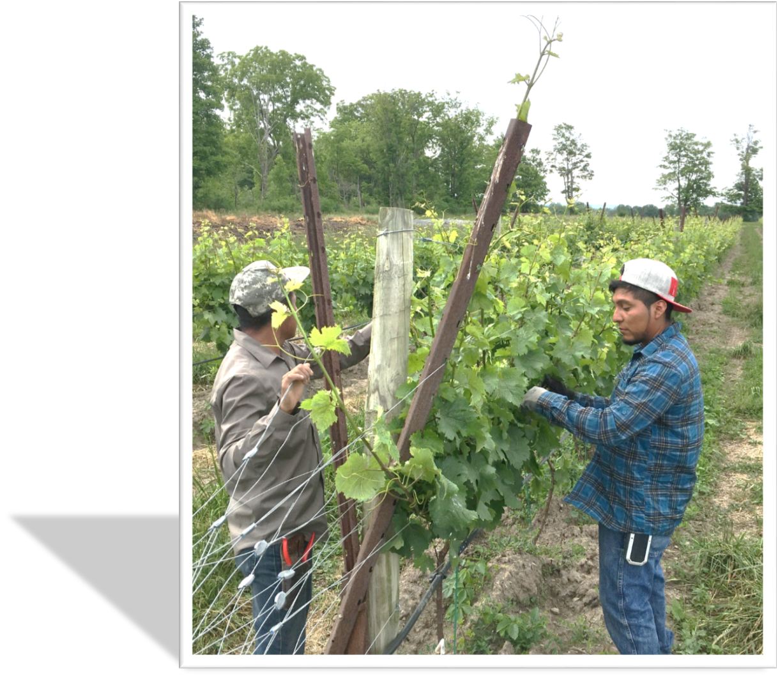
Key Topics
Historic labor market tightness.
Demographic change in the U.S., Mexico, Guatemala, and the Caribbean is influencing the farm workforce.
Technology to replace the most grueling farm labor may be closer than we think.

Slide 3
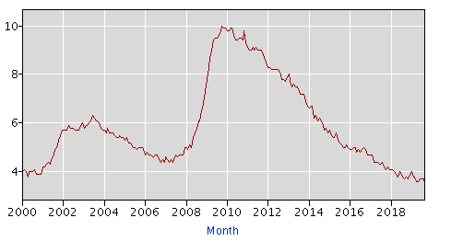
10 Year U.S. Unemployment Rate
The Wall Street Journal
May 10, 2019
Jobless Rate Falls to Lowest in Nearly 50 Years as Employers Ramp Up Hiring
Stronger-than-expected April job gains point toward solid growth, though fewer Americans are working
Source:
U.S. Bureau of Labor Statistics

Slide 4
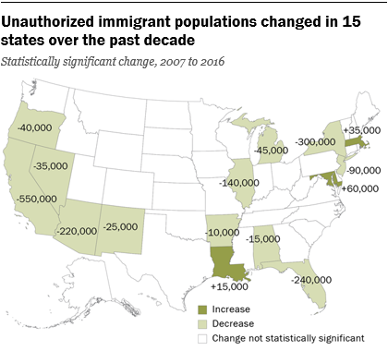
New York’s Unauthorized Population is Shrinking
Source: Pew Research Center

Slide 5
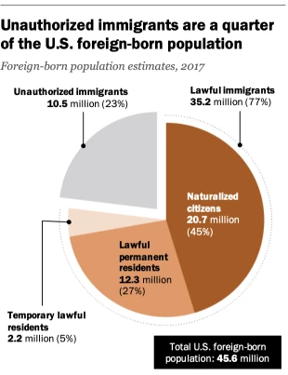
How does Pew Research Center come up with these numbers?
https://www.pewresearch.org/fact-tank/2019/07/12/how-pew-research-center-counts-unauthorized-immigrants-in-us/

Slide 6
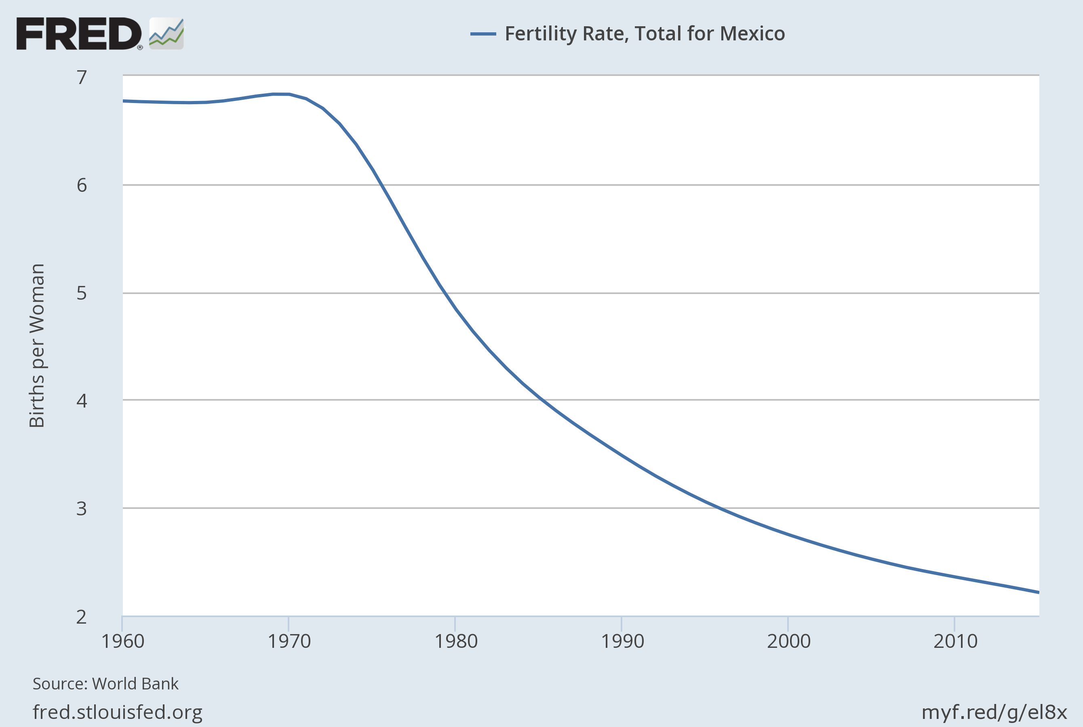
Fewer Young Mexicans Looking for Work
Notes:
Source: World Bank Release: World Development Indicators Units: Births per Woman, Not Seasonally Adjusted Frequency: Annual Total fertility rate represents the number of children that would be born to a woman if she were to live to the end of her childbearing years and bear children in accordance with current age-specific fertility rates.World Bank Source: (1) United Nations Population Division. World Population Prospects, (2) United Nations Statistical Division. Population and Vital Statistics Report (various years), (3) Census reports and other statistical publications from national statistical offices, (4) Eurostat: Demographic Statistics, (5) Secretariat of the Pacific Community: Statistics and Demography Program, and (6) U.S. Census Bureau: International DatabaseSource Indicator: SP.DYN.TFRT.IN World Bank, Fertility Rate, Total for Mexico [SPDYNTFRTINMEX], retrieved from FRED, Federal Reserve Bank of St. Louis; https://fred.stlouisfed.org/series/SPDYNTFRTINMEX, July 10, 2017.

Slide 7
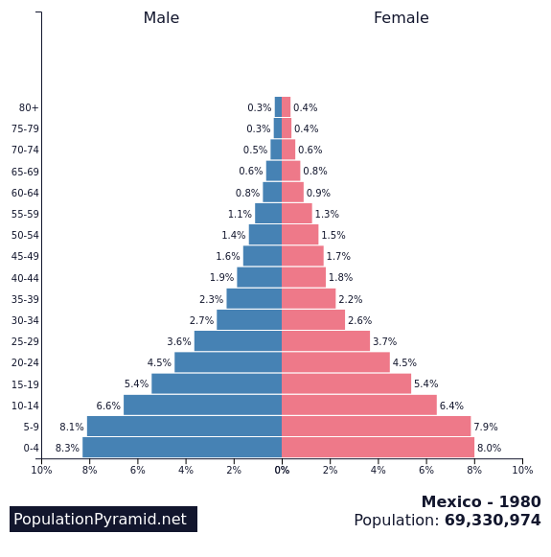
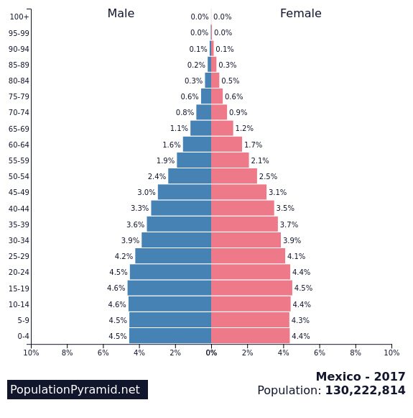
Mexico: A Stable Population
Source: CIA World Factbook
Notes:
A snapshot of the age structure of the population in 5 years-of-age increments.

Slide 8
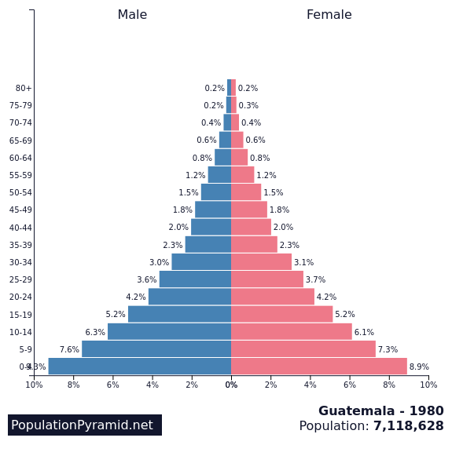
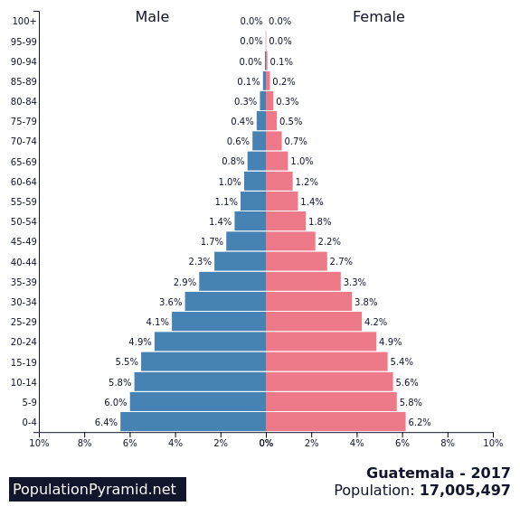
Guatemala: Still growing but slowing

Slide 9
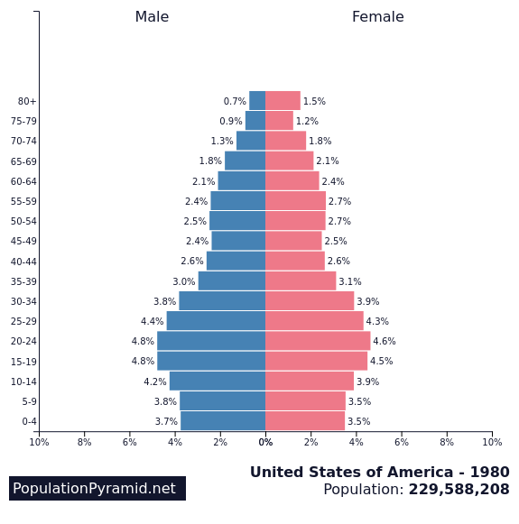
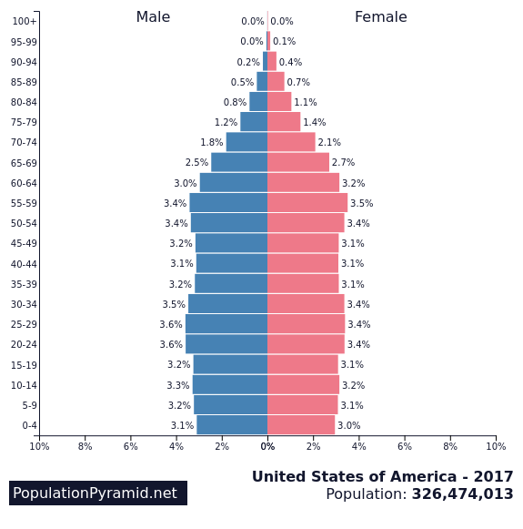
United States of America

Slide 10
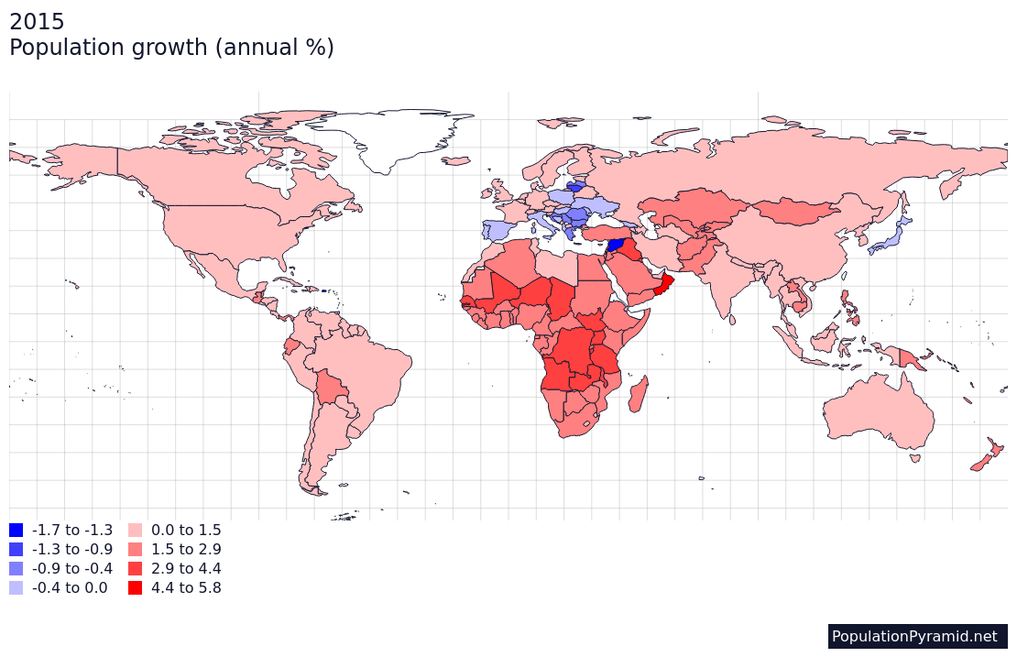

Slide 11
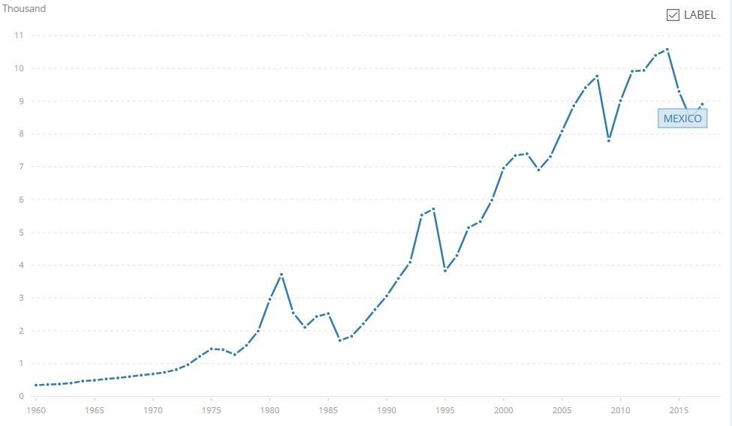
Mexico’s GDP in Current U.S. $ 1960-2017 Source: World Bank
NAFTA started in 1994
Notes:
This is gross domestic product per capita or per person in the country in today’s dollars. Economic development is definitely occurring in Mexico and more jobs are available there due to this activity.
NAFTA started in January 1994

Slide 12
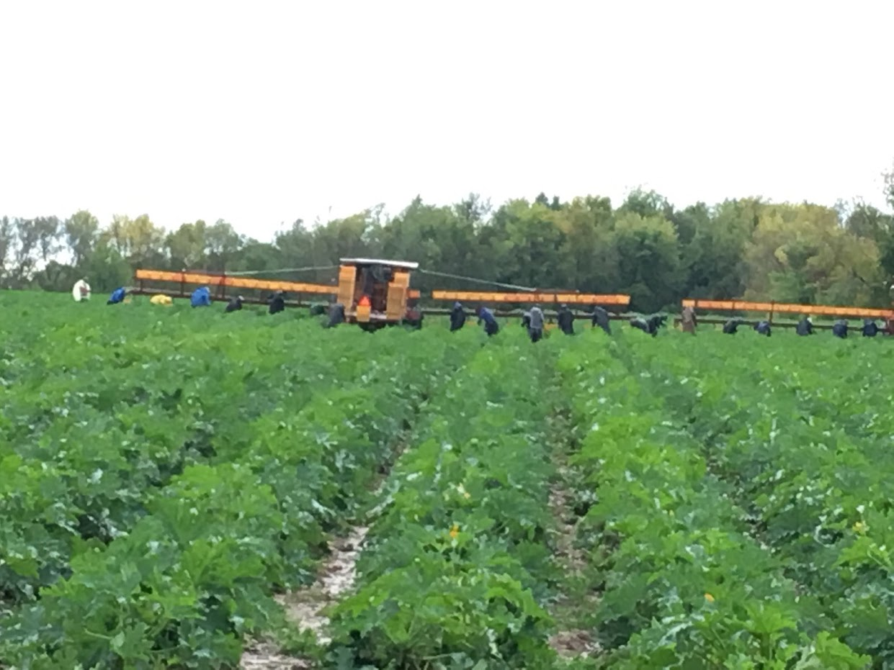
H-2A The Temporary Agricultural Guestworker Program
Must be an employer doing business in the U.S.
The work must be agricultural in nature.
Work must be full-time, at least 35 hours/week.
The need for work must be temporary or seasonal. Normally 10 months or less.
Growers, Farm Labor Contractors, and Agricultural Associations

Slide 13
High-Level Overview of the H-2A Process
File a job order with the NYS Department of Labor, 75-60 calendar days before workers are needed.
Form 790 and the NYS attachment to Form 790.
NYSDOL initiates search for local workers.
Get housing inspected and approved.
File an H-2A Application with the Chicago National Processing Center, Form 9142.
Recruit for Local Workers.
Advertising in print newspapers locally and in two other states
Qualified local workers must be hired.
Complete follow-ups and additional paperwork with USDOL
Get certified 9142 from USDOL
Apply to USCIS (I-129) for visas for your workers.

Slide 14
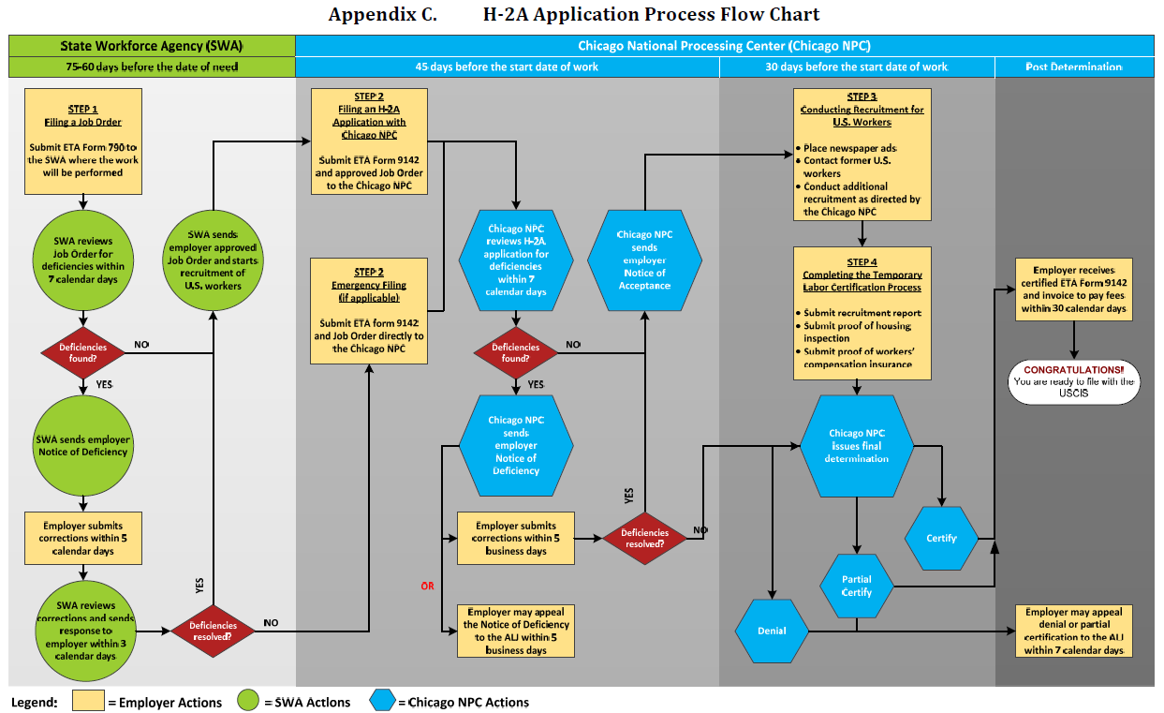
H-2A Process Flowchart

Slide 15
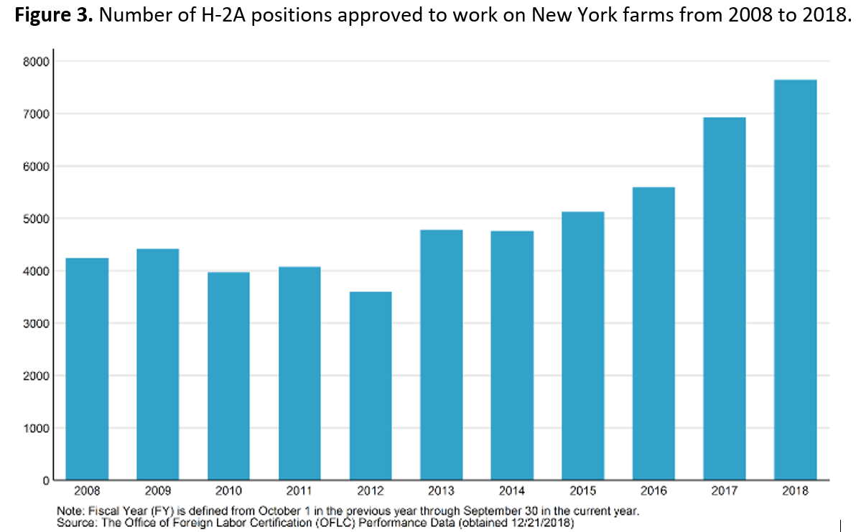
New York H-2A Growth
Notes:
New York Growers increasingly depend on the Temporary Agricultural Worker Program, H-2A.
Traditional sources of migrant labor within the country have dwindled. Growers find the program expensive and difficult but this is offset by its reliability. It’s about risk management.
Overhead costs of the program tend to favor larger growers.

Slide 16
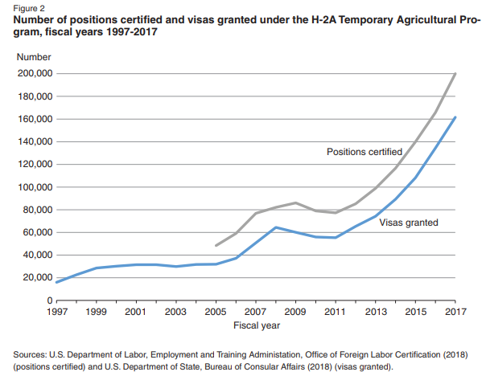
U.S. H-2A Growth
Notes:
Two numbers, positions certified are the overall number of jobs approved. Visas granted are people coming into the country to fill those jobs. Some positions do go unfilled and some workers finish one job and take another one.

Slide 17
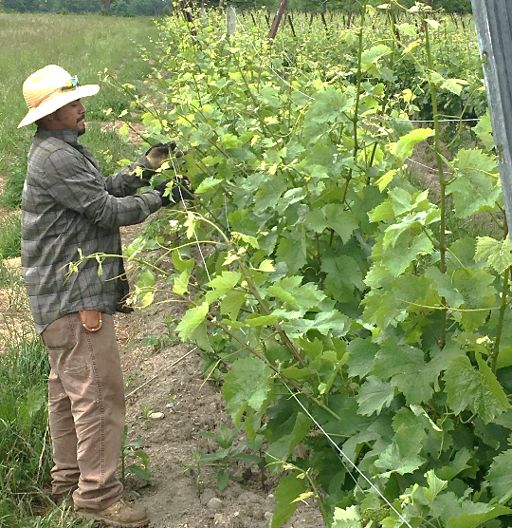
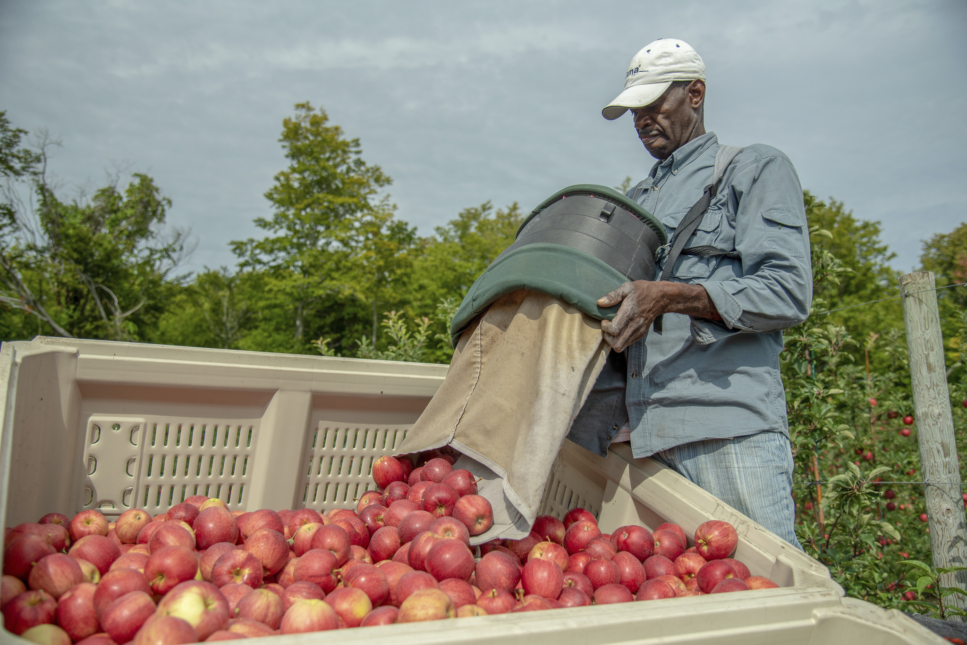
H-2A Employees in New York
Mexico
Also: Central America, Australia, South Africa
Jamaica
Notes:
Mexico and Central America are traditional NY sources for H-2A. Jamaica is also a significant source, especially for tree fruit growers. There are many H-2A workers who return year after year, I learned of one many who returned this year for his 40th season.

Slide 18
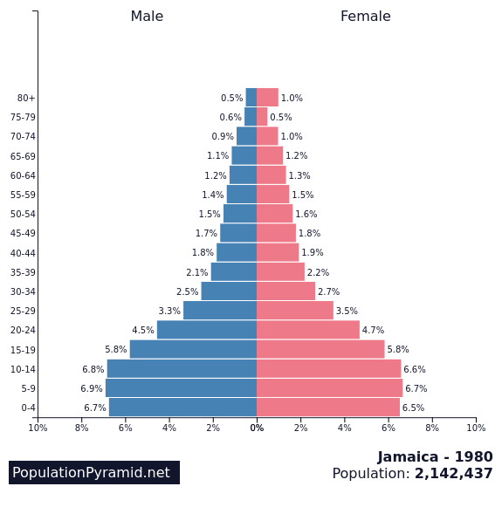
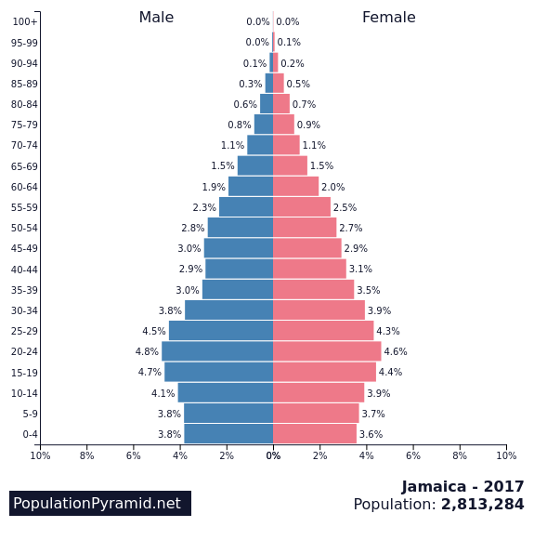
A Shrinking Population(?): Jamaica

Slide 19
The Challenge
Labor is increasingly scarce, but farmers need excellent employees in order to operate successful businesses.
Even with U.S. immigration policy reform, labor will remain scarce.

Slide 20
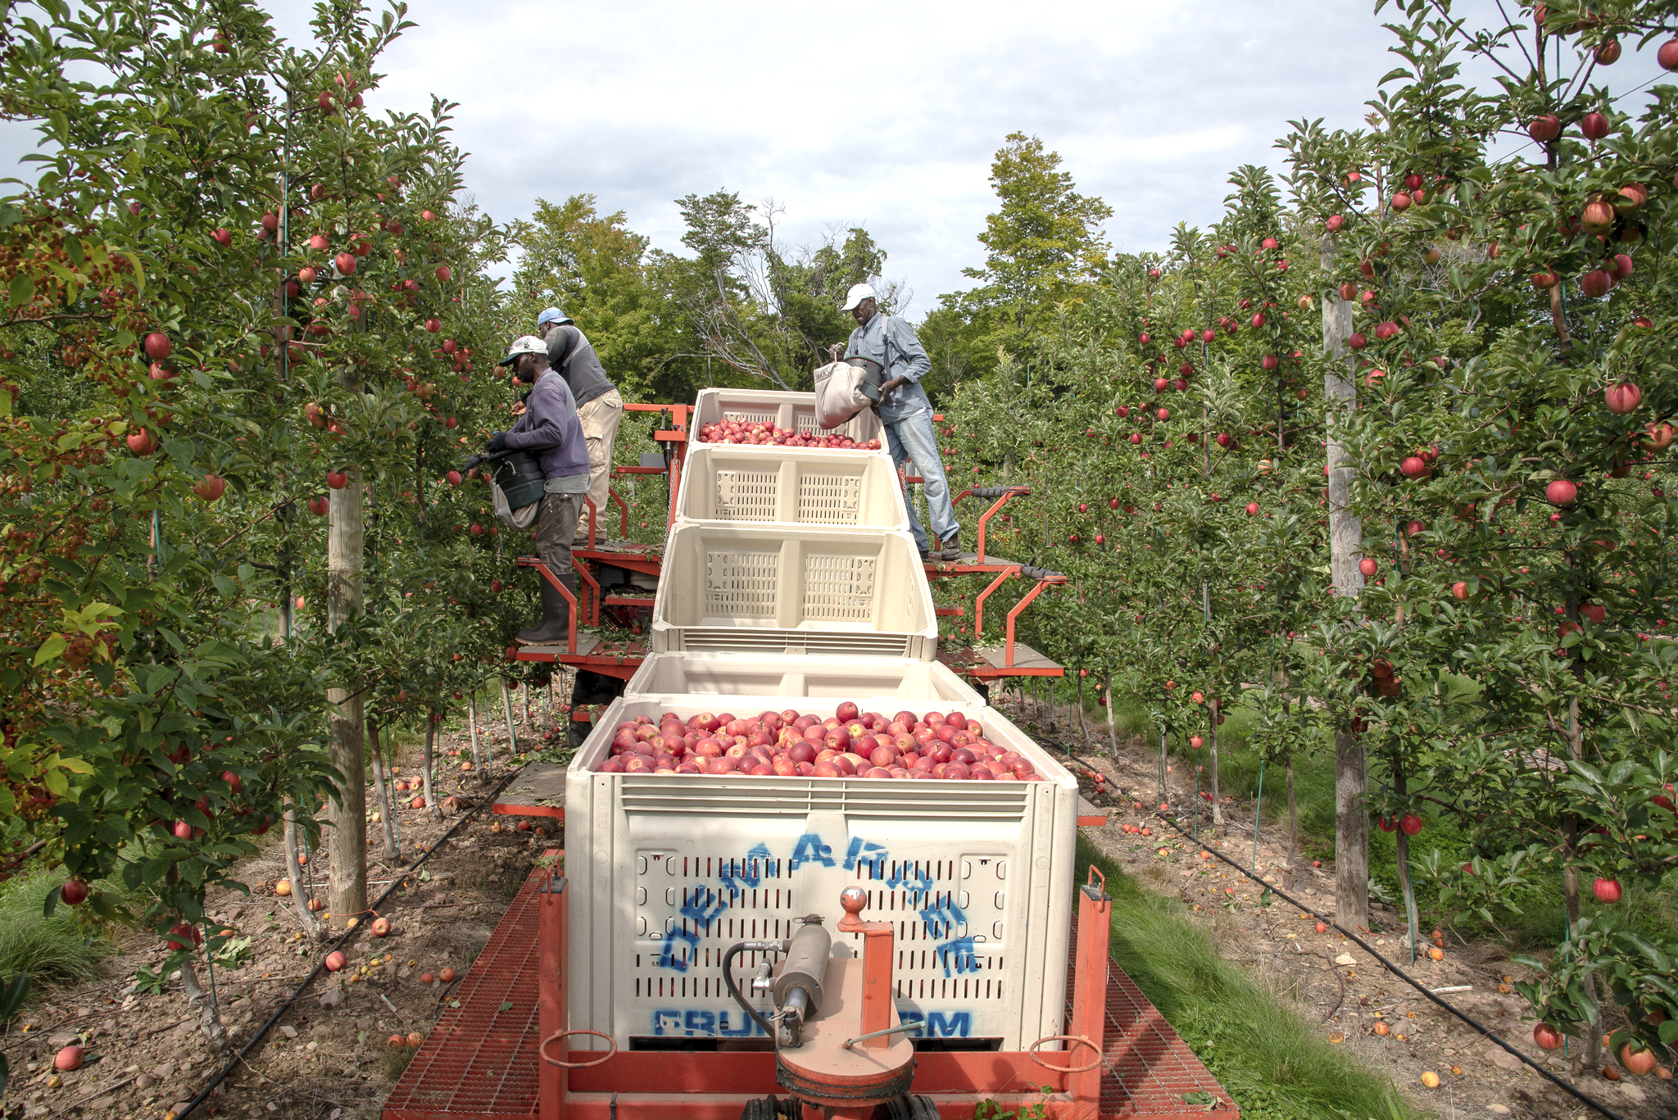
Labor Availability is a Major Driver of Change
Apple picking with platform
Notes:
Modern fruit orchards are built with a trellis. The purpose is to increase density and production per acre but also to reduce labor needs. Platforms move between the trellises making the work easier. It also makes it easier to prune the trees and it is anticipating robotic harvester. Robots can “see” the apples on the trellis, much harder on a natural growing tree.

Slide 21
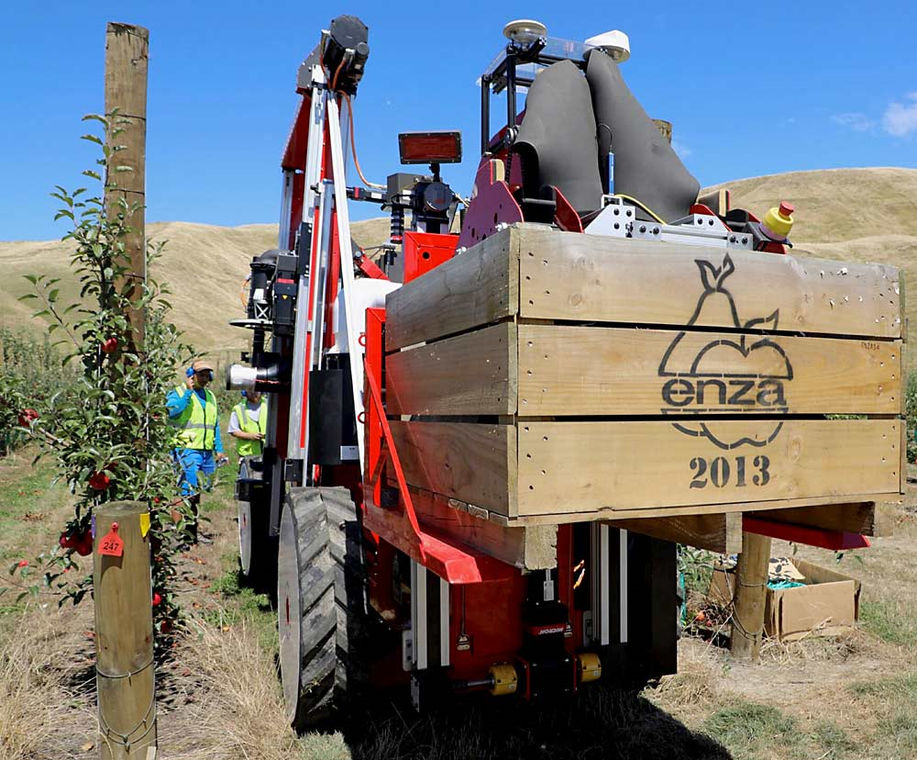
Mechanization Bridging to Automation
Commercial robotic apple harvesting is happening now.
Strong potential to reduce labor needs.
Very high capital investment.
Labor shortages and turmoil will speed adoption of technology.
Notes:
This is a commercial operating apple harvesting in New Zealand.

Slide 22
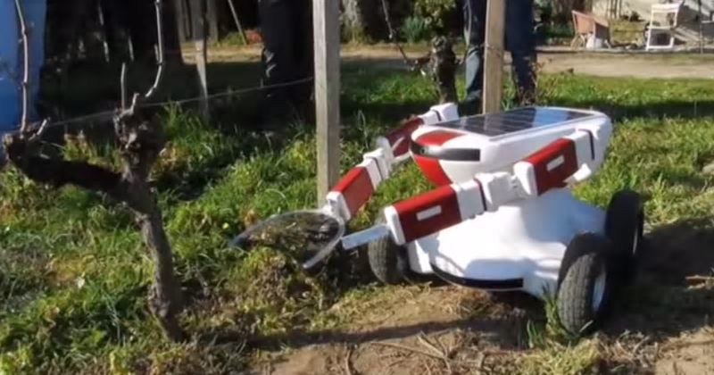
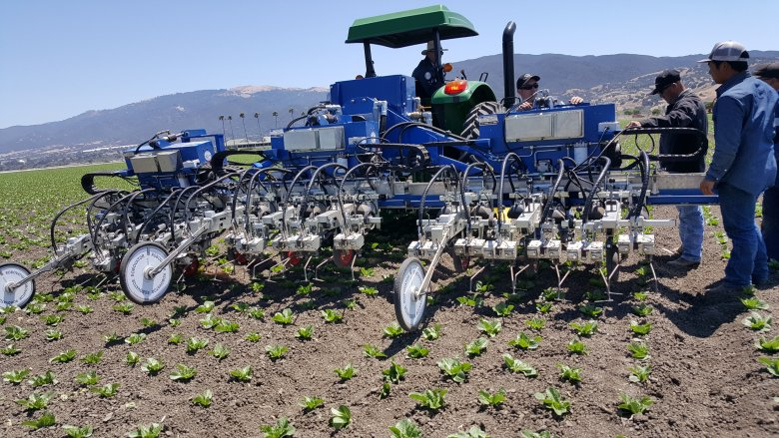
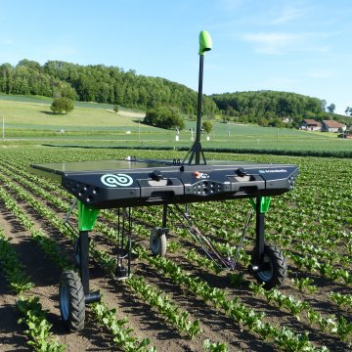
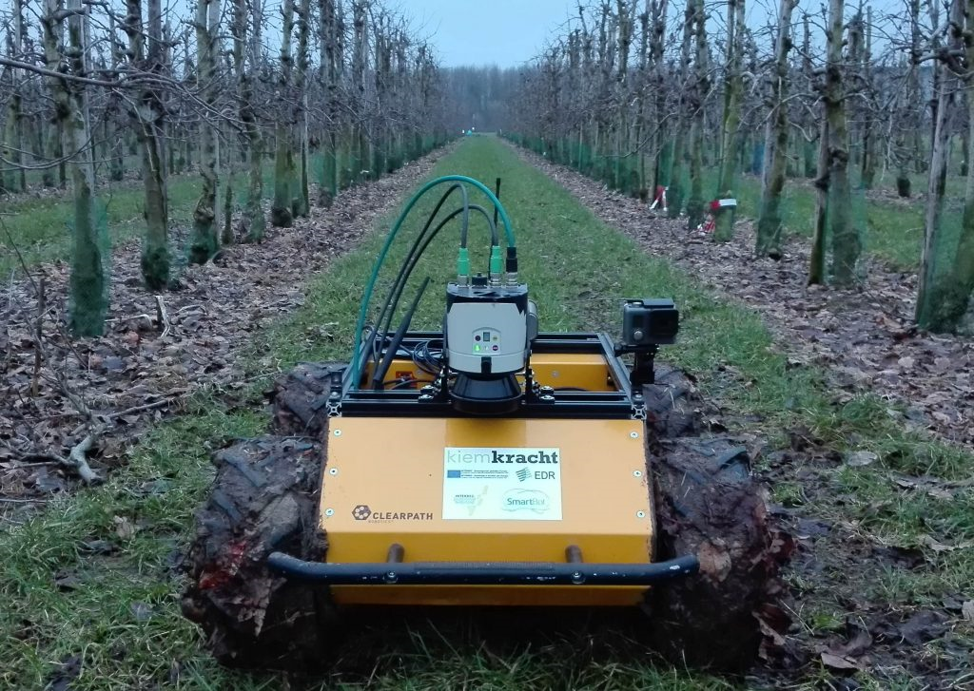
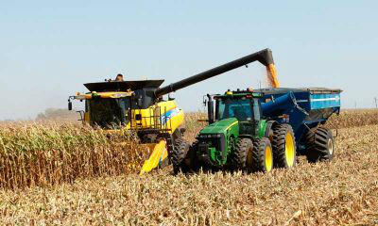
Replacing Manual Labor
Notes:
Top right: a robot pruning suckers from trees fully automatically. Below that is another orchard robot.
Center is a solar-powered vegetable crop weeder.
Automation is also coming at larger scales. The combine has an operator but the grain cart is pulled by a fully automated tractor, no driver.
A tractor mounted lettuce weeder operating in California, with some of the people it may displace.

Slide 23
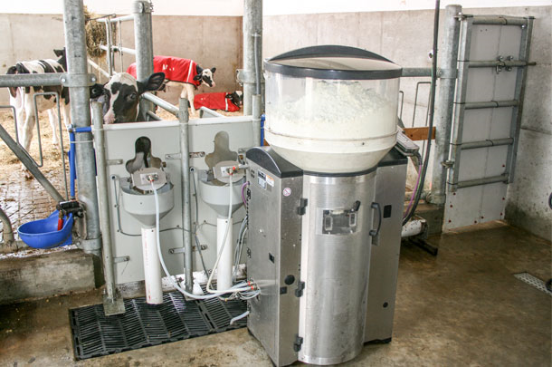
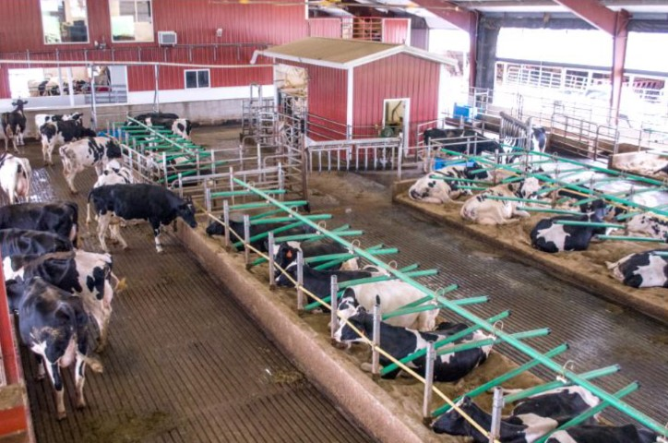
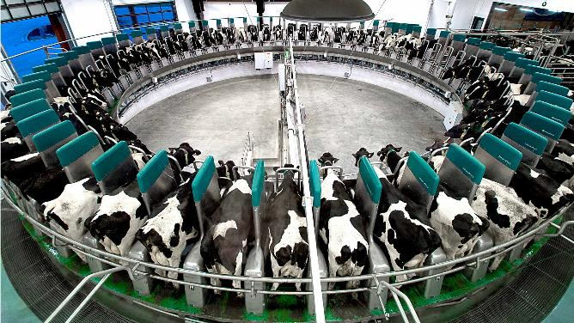
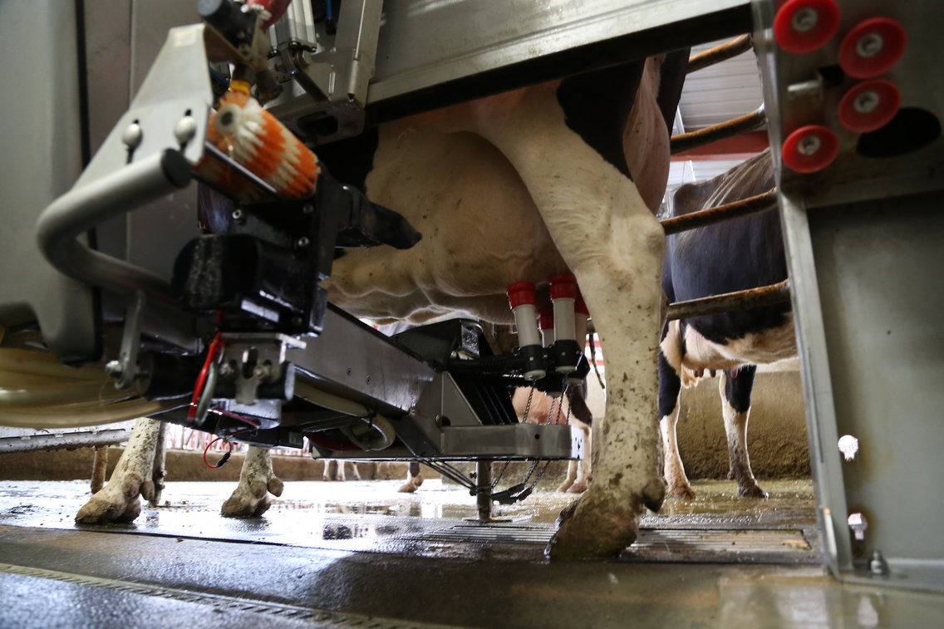
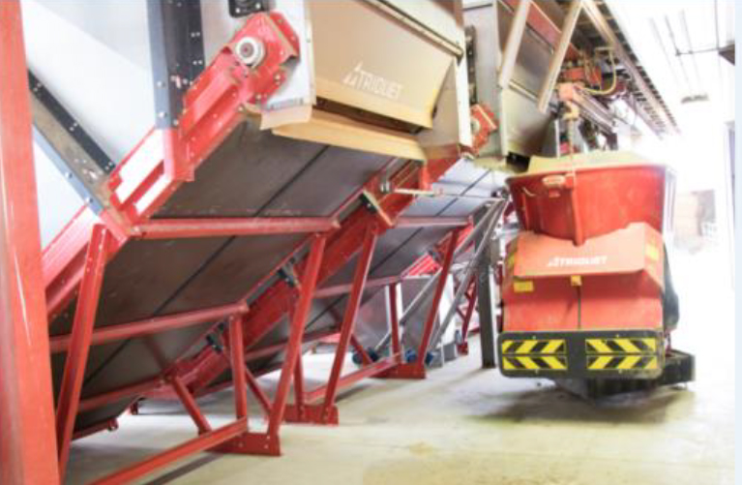
Dairy Automation
Notes:
A typical robotic milking facility, the robot is in the small shed in the background. The actual milking robot.
A feed mixing robot in “the kitchen.”
A robot that automatically mixes formula and feeds calves.
A fully automated, high-speed milking carousel for large-scale automation.

Slide 24
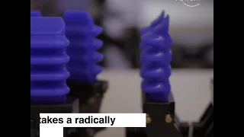
Robot Capabilities
More dexterous than you thought…
More mobile than you thought…

Slide 25
Robotic Outlook
“In the agriculture and food industries, the use of robots is very promising. Robots enable us to make up for the shortage in the work force. It is also possible to achieve higher production with robots...”
- EJ (Erik) Pekkeriet, Senior Business Development Manager Agro Food Robotics, Wageningen University, the Netherlands
Pekkeriet predicts that robots will be doing all the menial, repetitive work in ten to twenty years from now.

Slide 26
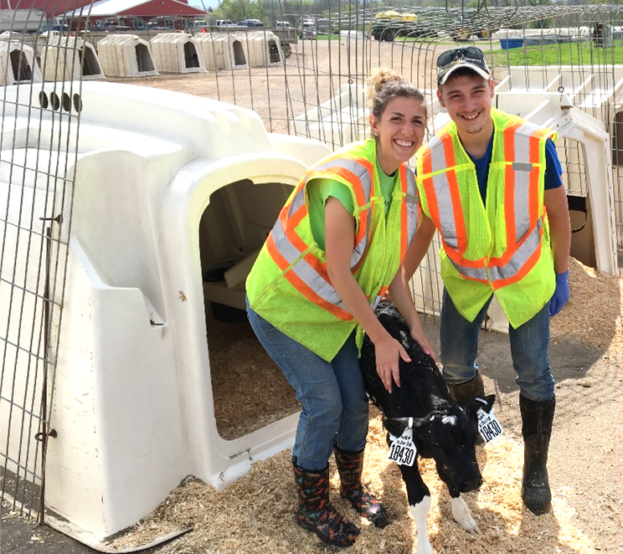
The Agricultural Workforce of the Future
Heavy manual and repetitive labor will be largely automated.
People will maintain and operate machines, make decisions based on information, and handle specialized tasks.
High skill, high wage jobs will remain.
Employees recruited from all walks of life (rural-urban, native-immigrant) to find careers that combine biology, technology, and information. People who like plants and animals, not cubicles.

